Slide 1
Modeling Pedestrian Flow in a Crowded Building
Battista P., Ferradini C. A., Biella A., Fioroni L., Guillement V.

Slide 2
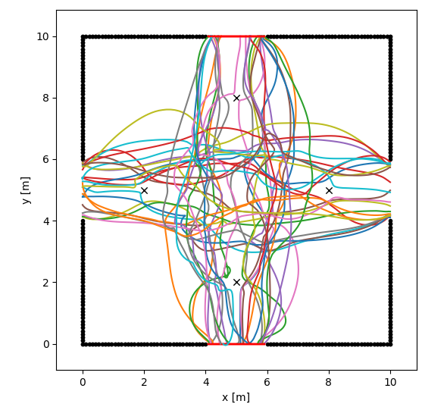
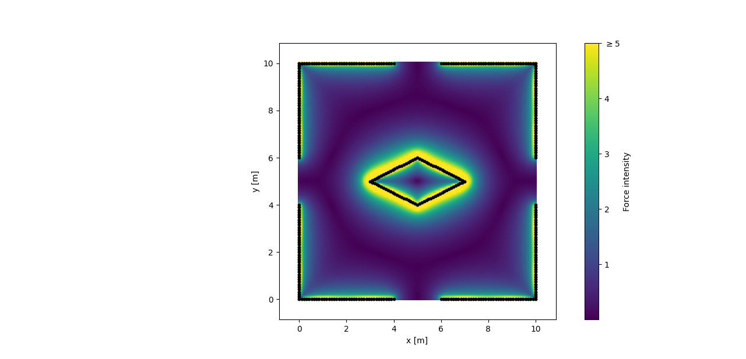
Introduction
Hello World

Slide 3
Goal
Hello World

Slide 4
Model

Slide 5


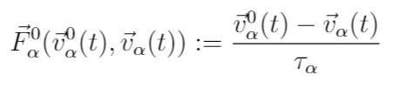



Model
Goal:
Private Sphere:
Border Effects:

Slide 6


Model

Slide 7
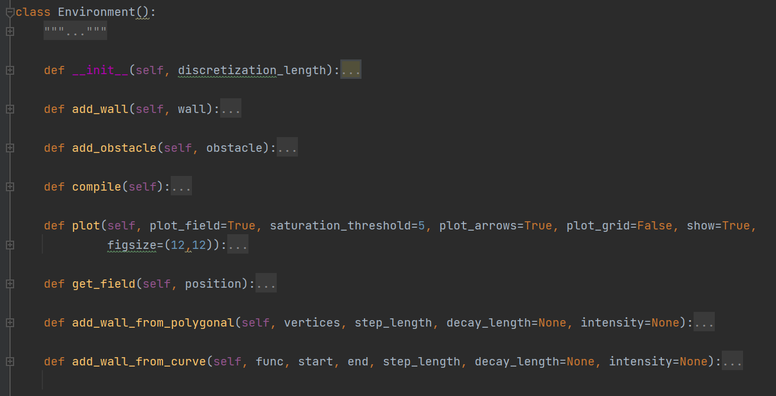
Environment

Slide 8
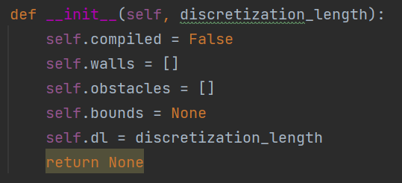

Slide 9
Environment
Hello World

Slide 10
Agents

Slide 11
Agents
Hello World

Slide 12
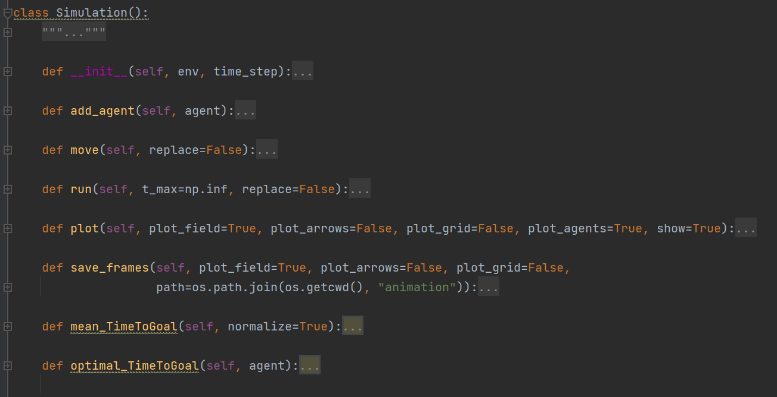
Simulation

Slide 13
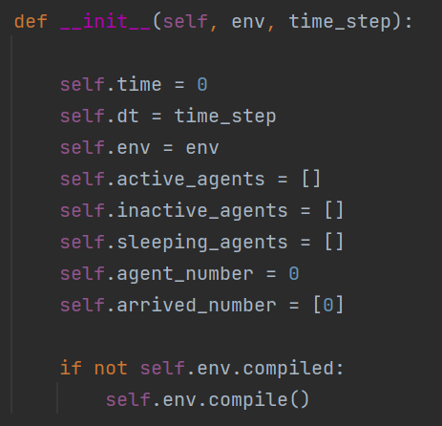

Slide 14
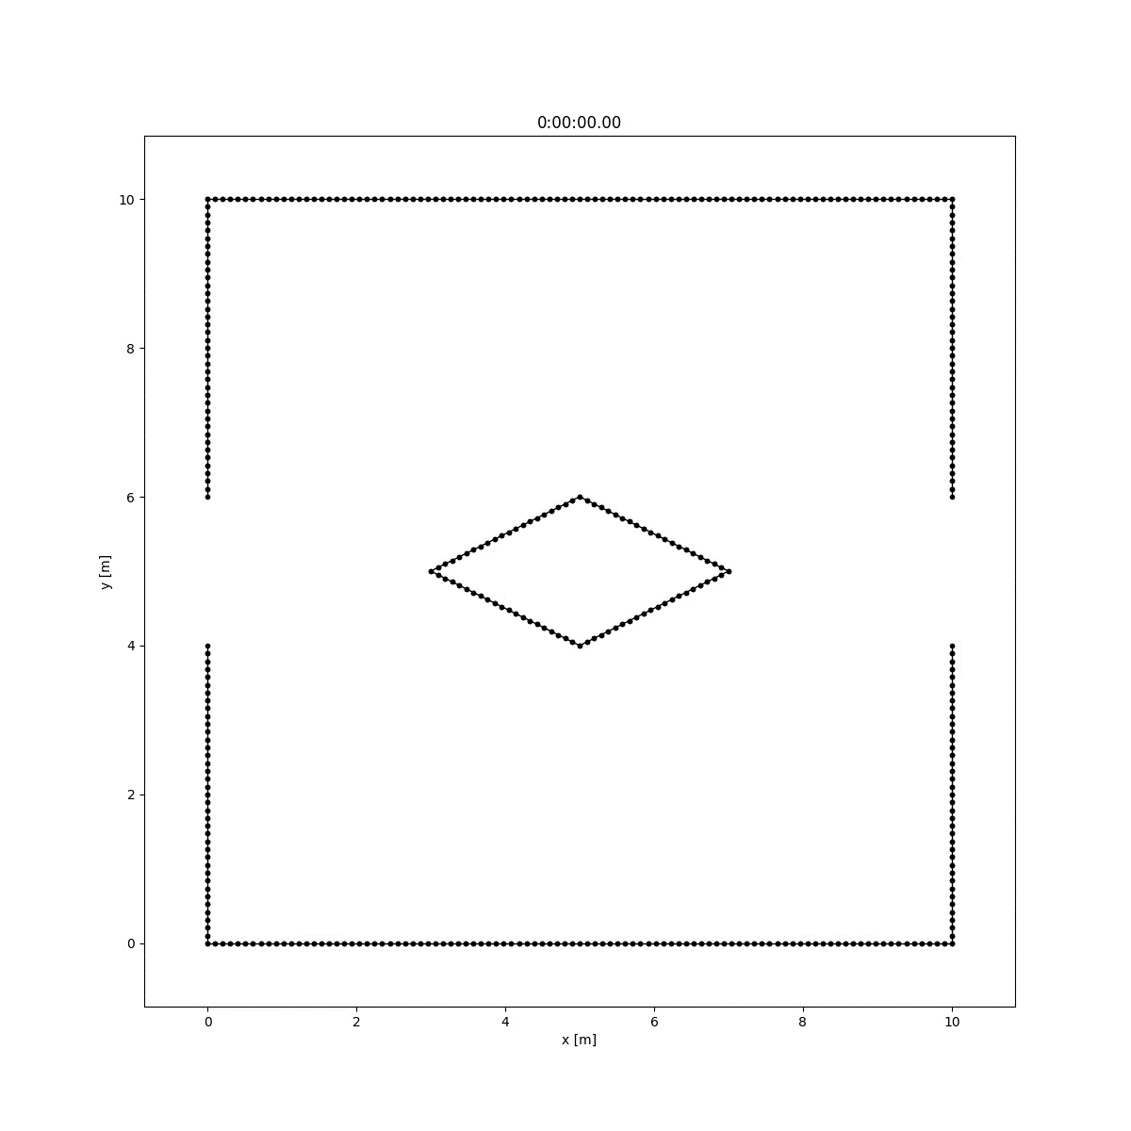
Simulation
Hello World

Slide 15
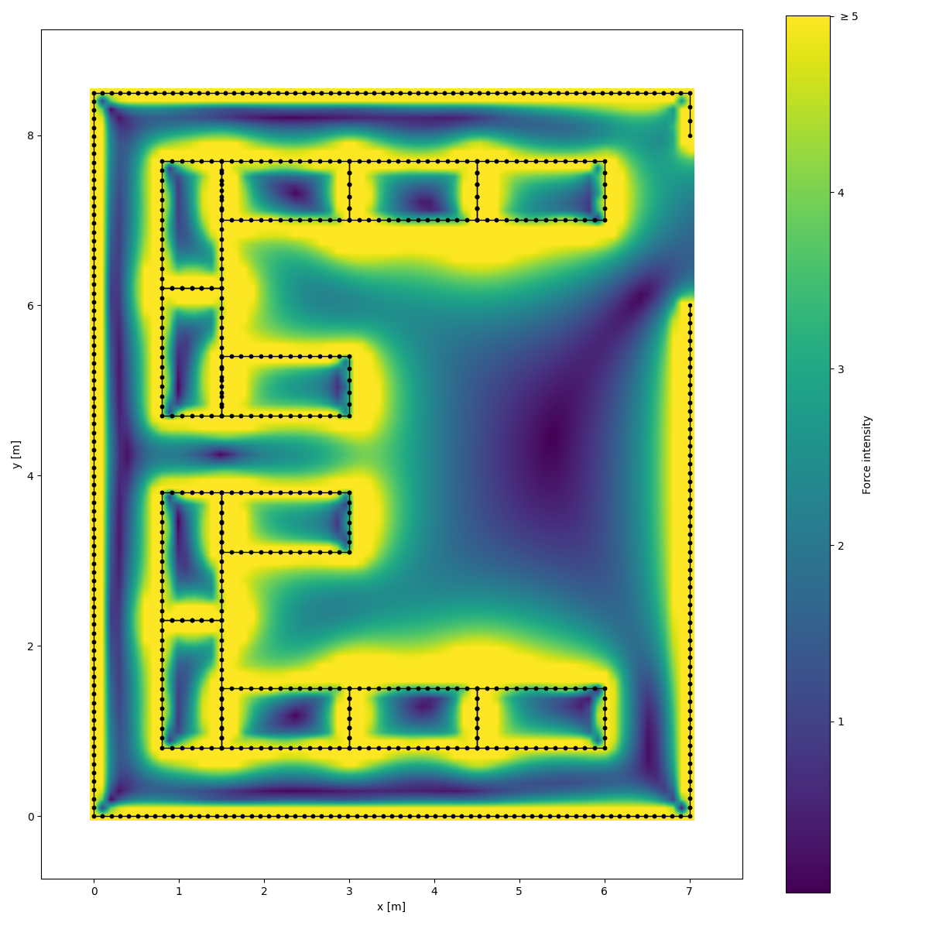
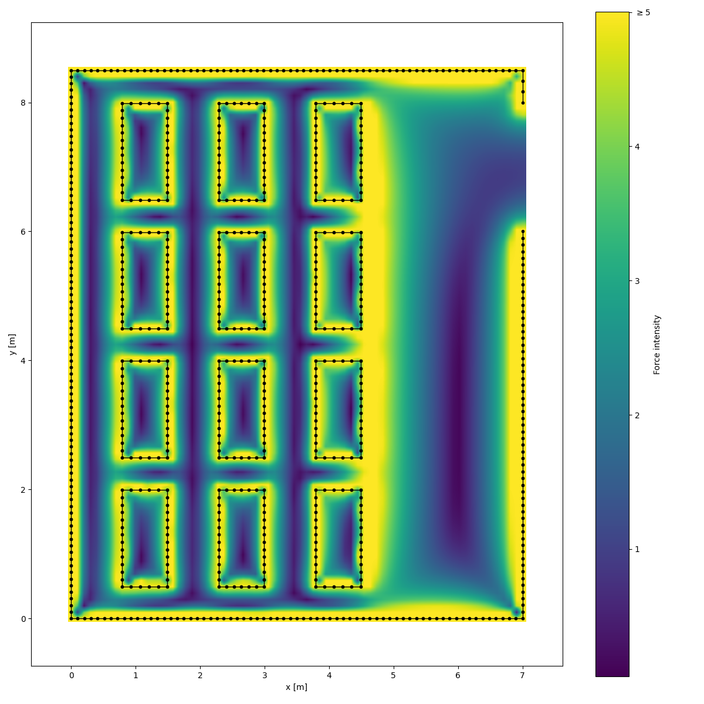
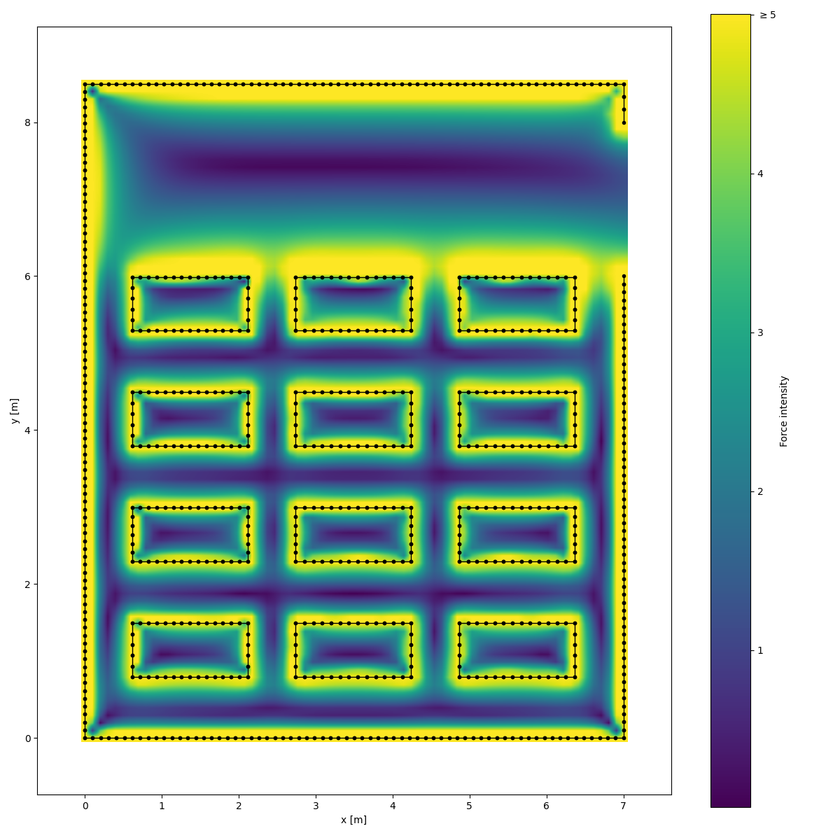
Example: Classroom

Slide 16
Example: Classroom

Slide 17
Problems & Difficulties
Hello World

